Slide 1

Exploratory Data Analysis
- NYC Flight Data
Sai Ram Julakanti
- Data Scientist

Slide 2
Agenda
What is this data refer to?
What is this data consists of?
Analysis on key fields.
Relation between fields.
Understanding the data.
Final Observations.
Actionable Insights.

Slide 3
NYC Flights Data
Data from 2013.
16 unique Carriers.
3 Origins from NYC & 105 destinations across world.
Departure & Arrival timing details are missing for few.
Reasons of delay are not mentioned.
Flight speed is not in the data .So included based on distance & Travel time.

Slide 4
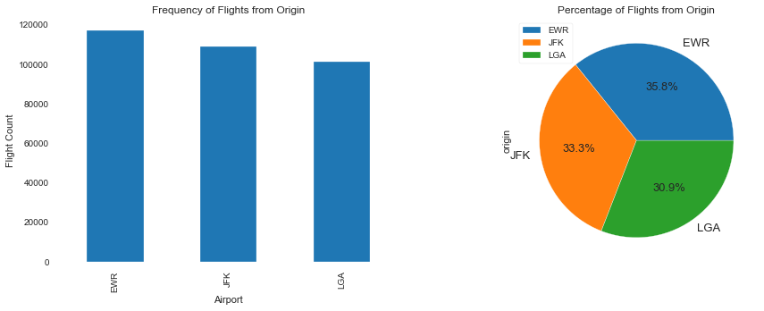
Origin

Slide 5
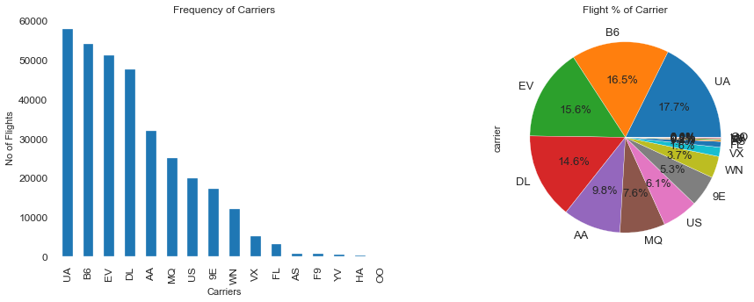
Carrier

Slide 6
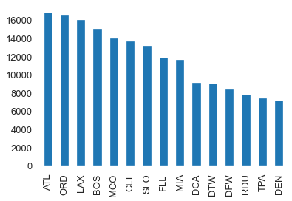
Destinations

Slide 7
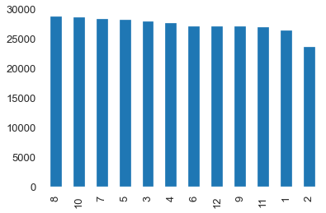
Month

Slide 8
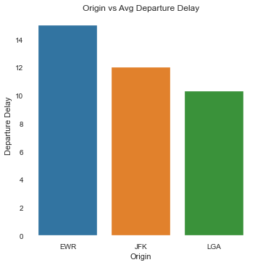
Origin vs Departure Delay

Slide 9
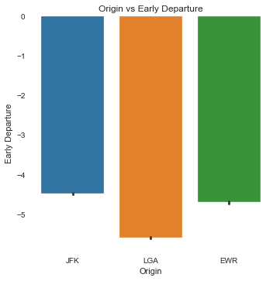
Origin vs Early Departure

Slide 10
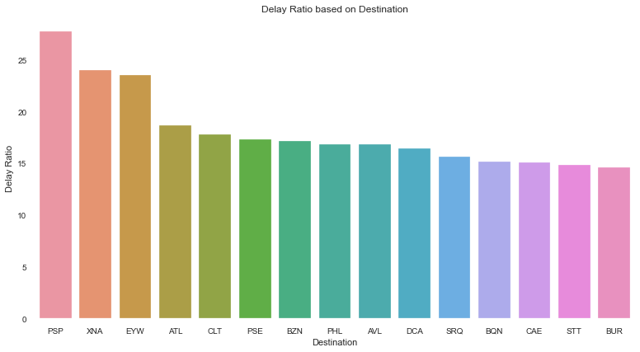
Destination vs Delay Ratio

Slide 11
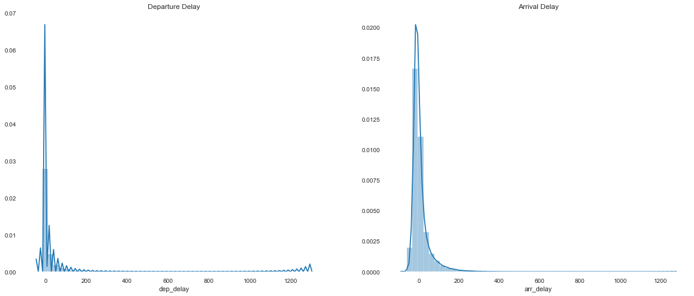
Departure vs Arrival Delays

Slide 12
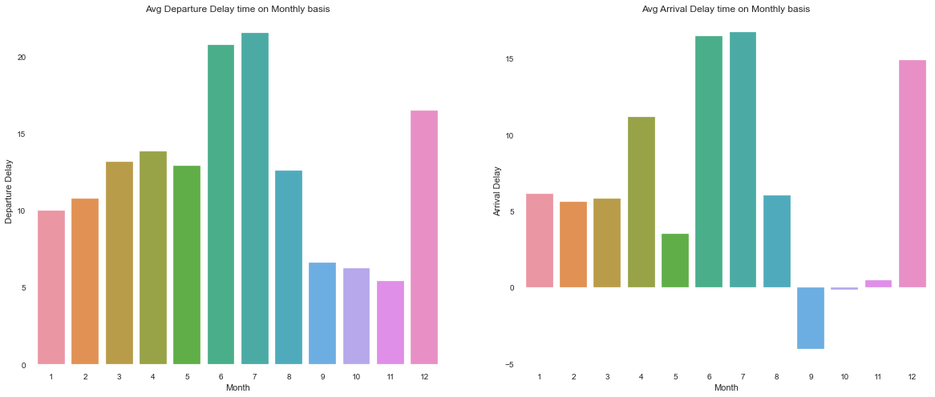
Month vs Departure & Arrival Delays

Slide 13
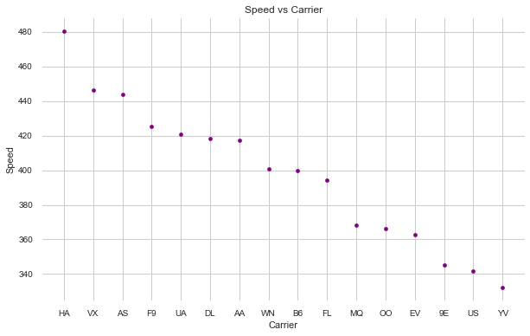
Speed vs Carrier

Slide 14
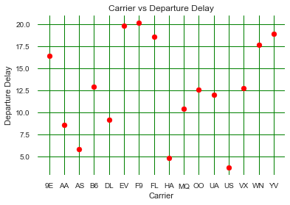
Carrier vs Departure Delay

Slide 15
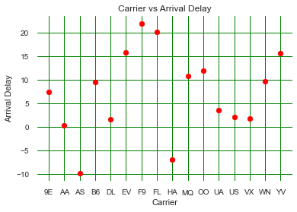
Carrier vs Arrival Delay

Slide 16
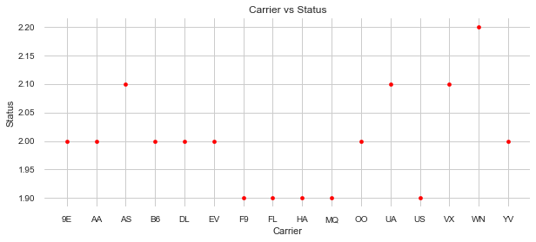
Carrier vs Status
1 = Not Good
2 = Good
3 = Extra Ordinary

Slide 17
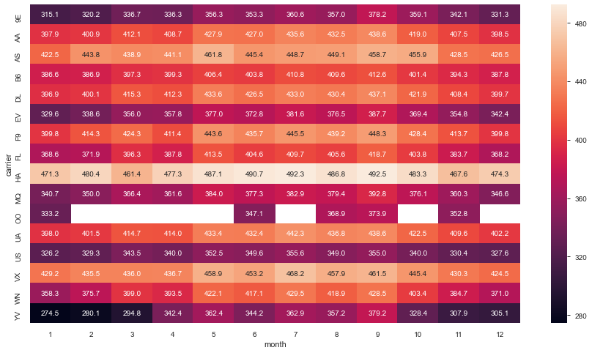
Speed vs Month Vs Carrier

Slide 18
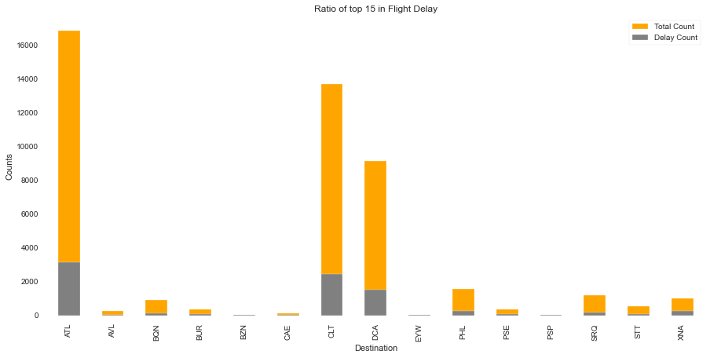
Destination vs Total count vs Delay Count

Slide 19
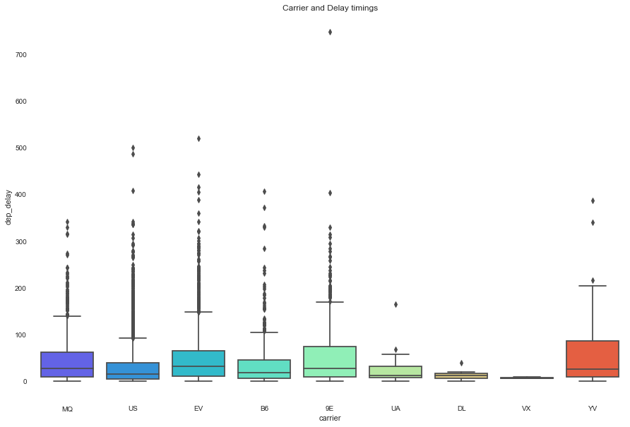
Destination vs Total count vs Delay Count - Deep Dive

Slide 20
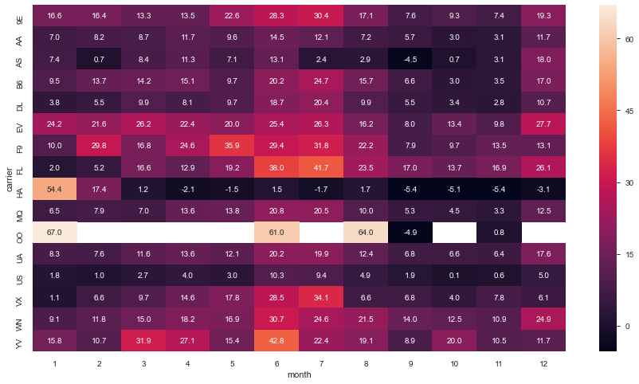
Carrier – Month – Departure Delay

Slide 21
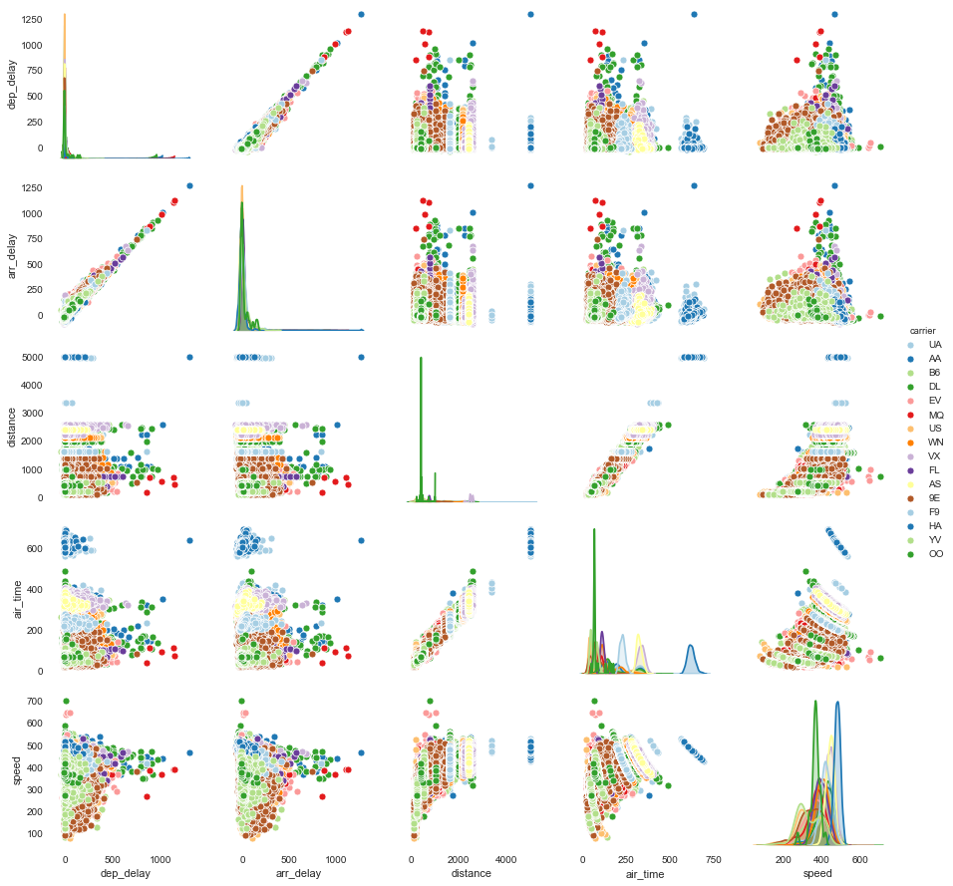
Pairwise Relationship

Slide 22
Actionable Insights
Highest Travels & delays are happening in the month of May,June,July,August & December and this maybe due to Summer holiday & festival season in USA.
We need to put extra staff in the airports for faster check in, security checks, Immigration process etc. to reduce delay caused by passenger traffic.
Feb month having less travels when compared to other months.
If Companies can provide offers/discounts in this month, Chances are high that passengers may get attracted to travel.

Slide 23
Actionable Insights
Out of 105 destinations, almost 10 destinations having 15% delays and only MQ,B6,9E,UA,YU carriers providing services for these destinations - Based on the analysis these carriers having comparatively less average speed.
If these companies allow High speed, may be this issue gets resolved.
EWR is the busiest airport and having high departure delays too.
we need to have more staff recruited to control the passenger traffic, may be spreading the flights across the clock, introducing new automated machines like automatic baggage check in etc.

Slide 24
Actionable Insights
HA & F9 carriers having good average speed limits, but the performance is not good when covering the travel time.
we need to check on all flights of these companies on speed limits which reflect the average delay time and may be providing reports to the pilots.
FL,MQ & US are performing not good in covering the delay time and speed limits are also very low.
If companies are allowing more speed limits irrespective of fuel consumption, Delay time can be reduced.

Slide 25
